Slide 1
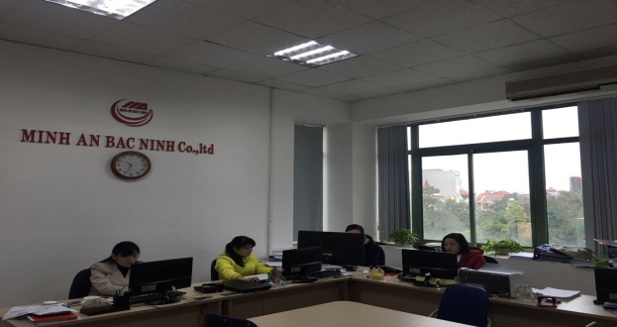


Add Office Sale: Zoom 303, Trung Thanh Towe, No 10 Nguyen Dang Dao Str, Tien An ward, Bac Ninh city Tel: +84-241.3899.688 Fax: +84-241.3899.686 Hotline: 0984.500.668 Websites: www.minhan.org Email: office.bn@minhan.org Taxcode: 2300748209

Slide 2

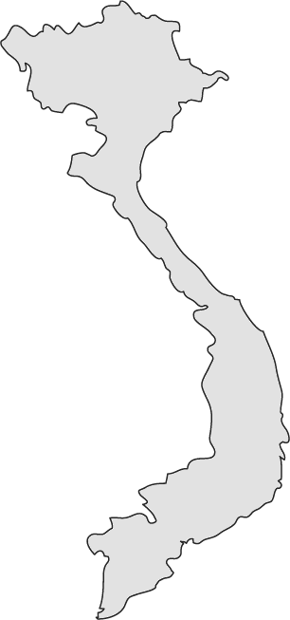






The Charm of Vietnam
Filled with quaint traditions
World’s leading producer of smartphones
AO DAI
national costume
Among the world’s most motorbike per capita
PHO
World-famous Vietnamese noodles
Top coffee exporter around the globe
TET
Vietnamese New Year

Slide 3

AGENDA
1
MINH AN BAC NINH CO.,LTD
2
WORLDWIDE NETWORK
3
PRODUCTS & SERVICE
4
CUSTOMERS REFER
5
CONTACT INFORMATION

Slide 4
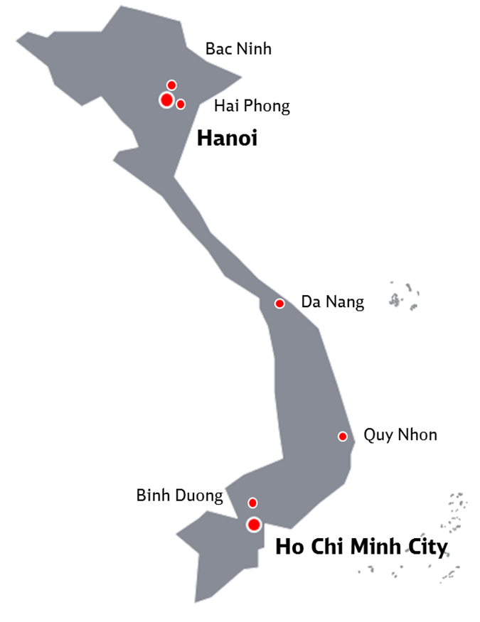
MINH AN BAC NINH Co.,LTD
  Registration Date : June - 2012
  Charter Capital : 1.000.000 USD
  General Director : Nguyen Huu Tho – Nationlaty : Viet Nam
  Finance Director : Nguyen Duc Son - Nationlaty : Viet Nam
  Director : Nguyen Quang Truong - Nationlaty: Vietnam
  Vice Director : Choi Young Jin - Nationlaty: Korea
  Vice Director : Dang Dinh Phuong
  Total Locations : 6
  Number of staff : 25
  Corporate Office : Bac Ninh
  Branch Office : Bac Ninh, Noi Bai, Hai Phong
  Agent Locations : HCM, Binh Duong, Da Nang, Quy Nhon
  Total Truck : 18
  Container : 12

Slide 5
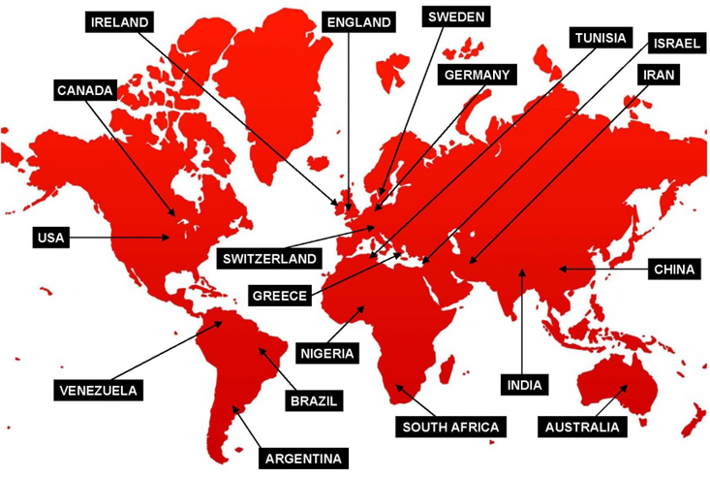
WORLDWIDE NETWORK
Globally presented in
19 countries worldwide

Slide 6


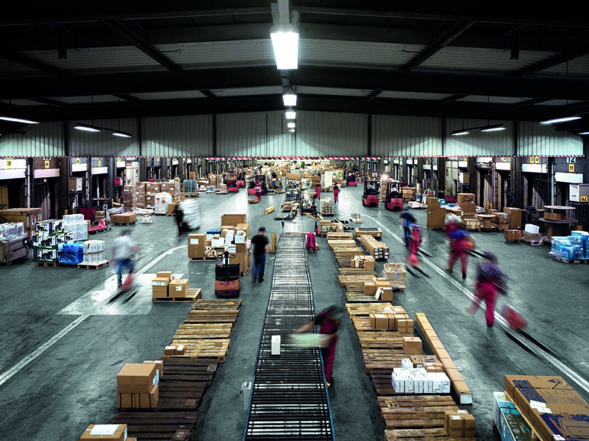

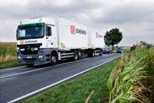

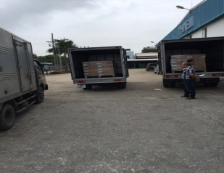
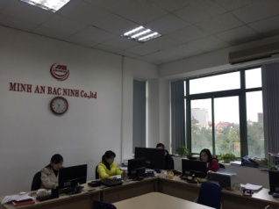

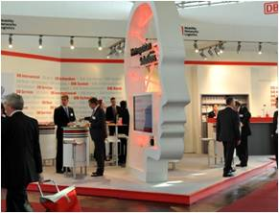

PRODUCTS & SERVICES
Ocean Freight
Trucking Consolation
Air Freight
Transportation
Industrial Packaging
Customs broker
Relocations
Fairs & Exhibitions

Slide 7

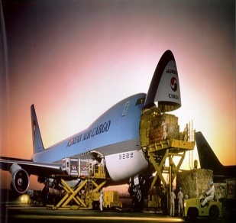
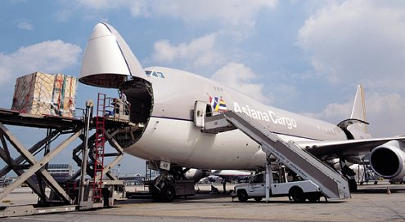
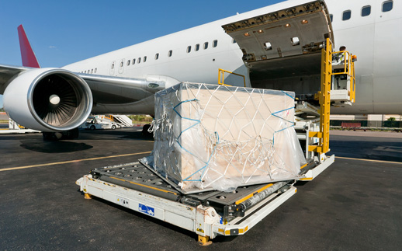
Air Freight
We transport your valuable cargo quickly and safely to its final destination with selected aircraft and global network cargo tracking system. Also, we operate a competitive air freight system ( Door to Door Total Service System) with the construction of carrier and customs EDI system
M.A Air Transport department consists of professionals who have a comprehensive knowledge and experience required for your air freight. We are always trying our best to bring satisfaction from client’s various
demands.
Service Coverage
Door to Door Service
Triangle Cargo Service
Custom Brokerage
Warehousing
In-land Trucking Service
Unloading cargo and installation of machine

Slide 8

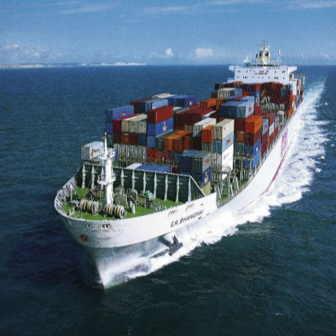
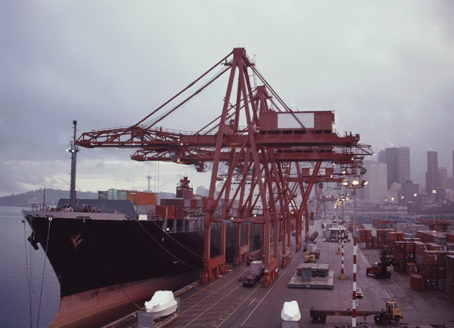
Ocean Freight
M.A is a way of main multimodal freight delivery type. Container transport, bulk cargo and tripartite maritime transport as well as from the main harbor of each country to the customer's designated place can be viewed as a starting point through a network solution that
connects the world’s major cities in one.
MMD has business cooperation and partnerships with global leading shipping company to provide suitable marine transport services for customers' needs. We promise stable, fast, accurate, and
cost-effective logistics services to you.
Project cargo with oversize and heavy cargo can be handled by us in the most effective way.

Slide 9
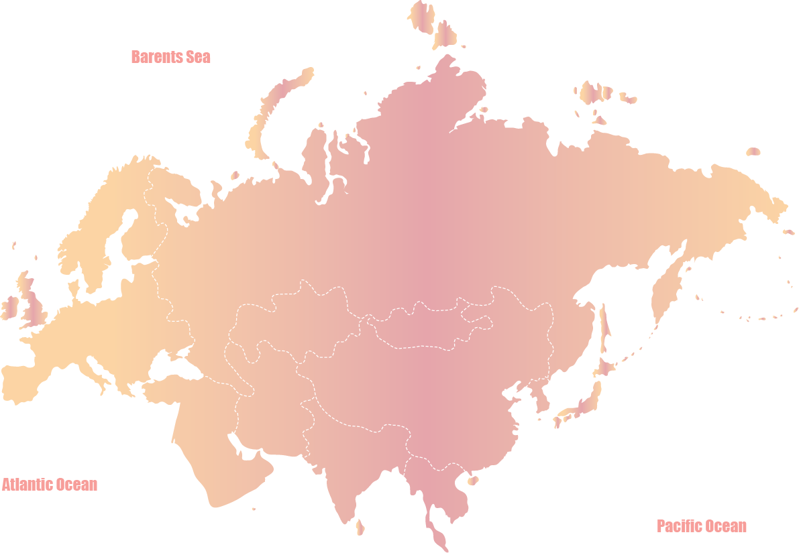
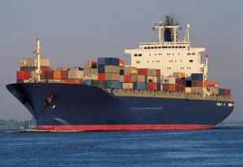
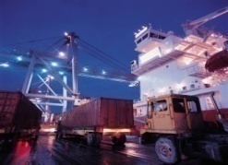
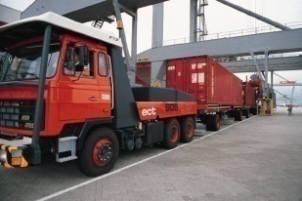
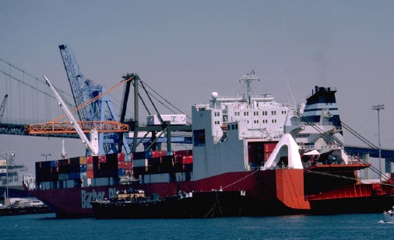
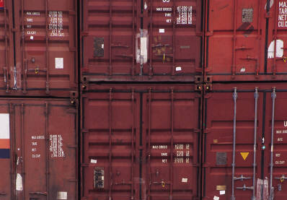




KEY POINT1 : Cargo tracing
BY SHIP
TRANSLOADING
BY TRUCK
DEPARTURE
ARRIVAL
1. SETTING TRACKING SYSTEM THROUGH INTERNALLY INCLUDING OVER-SEAS NETWORK
2. USING SAME TRACING SYSTEM WITH AGENT IN OVERSEAS
1. SETTING INDIVIDUAL SERVER SYSTEM FOR WAGON TRACKING
2. REGULAR TRACING INFORMATION TO CLIENT BY E-MAIL & FAX OR OTHER REQUESTED WAY
MMD
Client

Slide 10
KEY POINT2 : Tax exemption permission
For big project in Vietnam, investor get license from government and get tax exemption accordingly depending on project scope. Investor submit tax exemption document to custom house with list of materials and machine for building the project. Custom house will check and approve the Master list of items. For each shipment, they ll check the items in the Master list. If items in the Master list, custom sheet ll be done without paying tax.
After every period, client have to make report about importing status and tax to submit to Custom House.
At the end of project, client have to do make final report to the Custom House. Client’s report and Custom House ’report should be matched.

Slide 11
KEY POINT3 : Custom clearance
Receive orders/ request from carrier
Check shipping document (Bill, Inv, P/L and relating documents)
Checking form of CD (tax exemption or pay tax)
CD draft
Client’s chcking
Transfer data on custom system to get response from Custom
Procedure

Slide 12
KEY POINT4 : Storage & Delivery
For air shipment:
- Finish CD after 4 hr from received docs & full information for normal shipment.
Cargo can be delivered after 8 hours from arrival time
For sea shipment:
- Finish CD after 4 hr from received docs & full information for normal shipment.
FCL can be delivered after 12 hours from arrival time
LCL can be delivered after 3 working days of arrival time
Storage and DEM/DET charge shall be calculated basing on type of cargo.

Slide 13
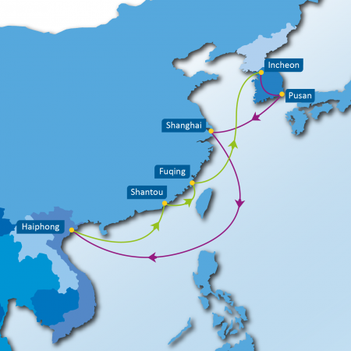
Transit time
Busan- Hai Phong | Osaka-Haiphong | INC-Haiphong | Shanghai- Haiphong
5-6 days | 6-7 days | 7-8 days | 5-6 days

Slide 14
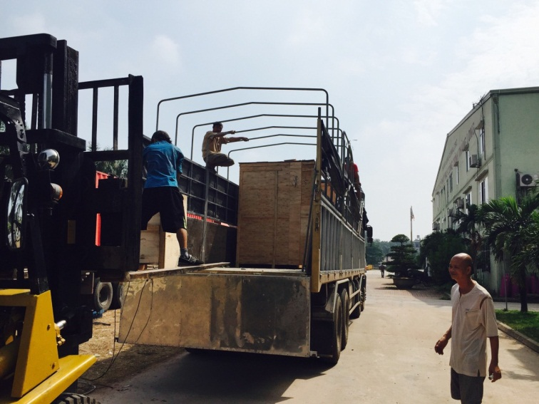
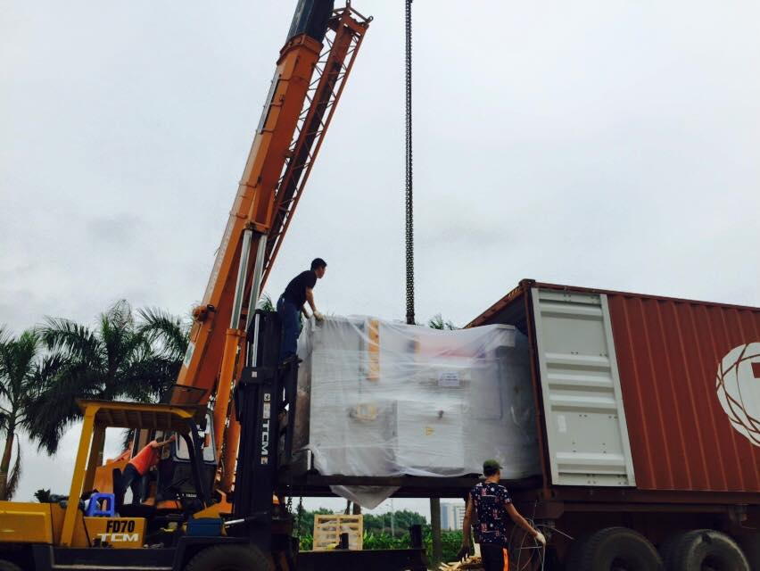
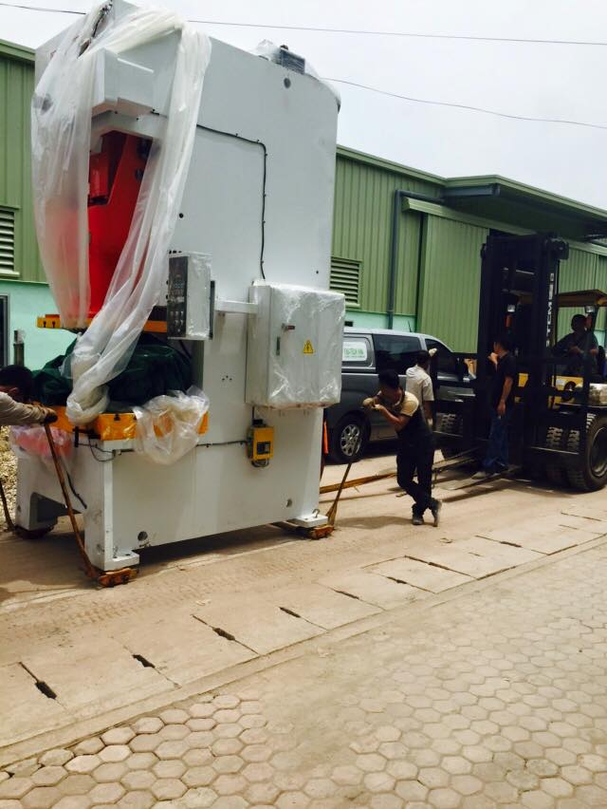
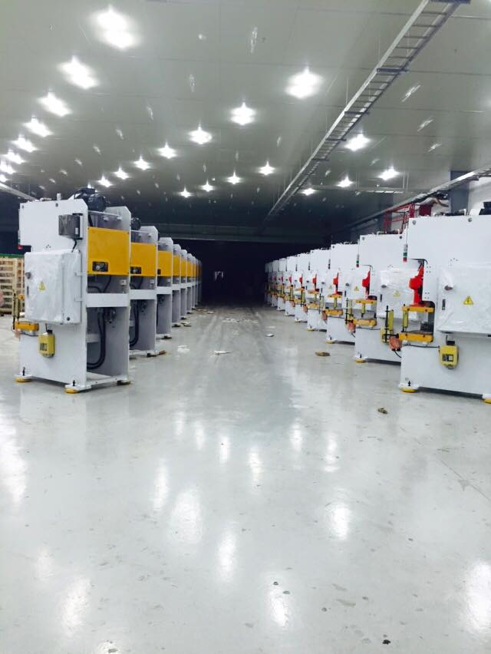
PROJECT EXPERIENCE
1. Delivery and installation for factory in Bac Ninh

Slide 15
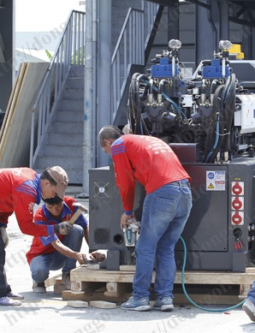
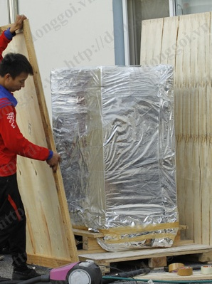
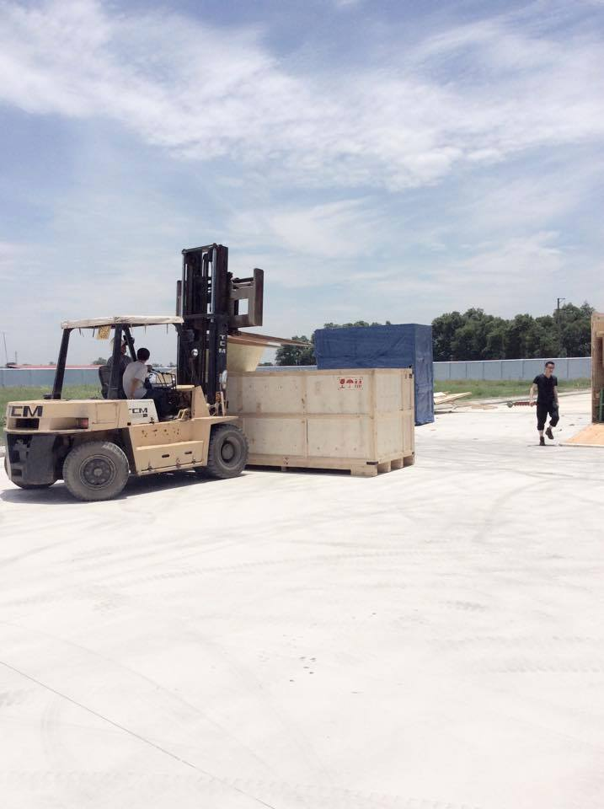
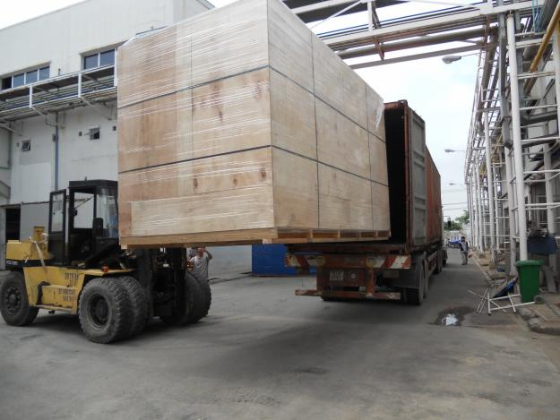
PACKING – SERVICE
Wooden packing and tuffing in container at HUNG YEN factory.

Slide 16
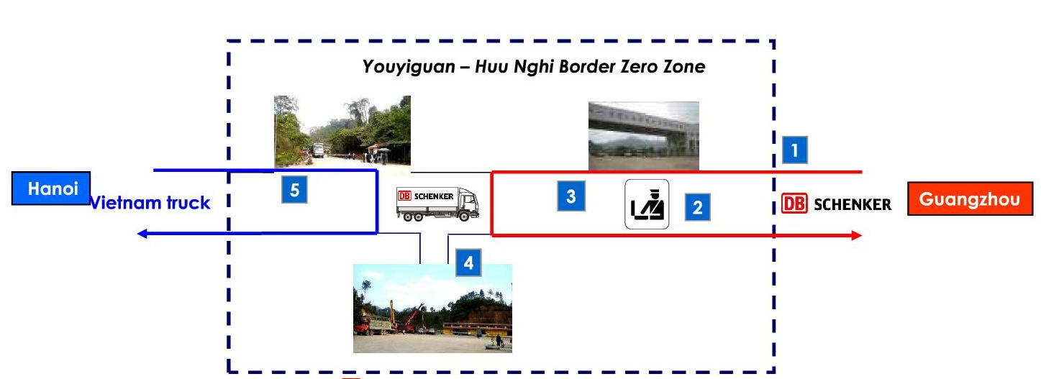


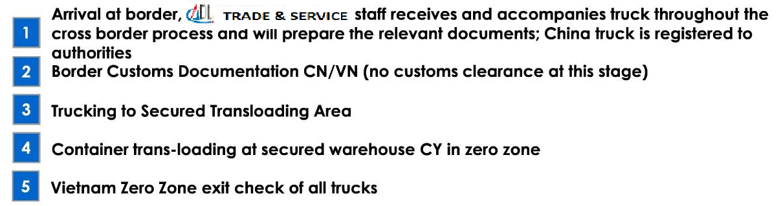
CROSS BORDER TRANSPORT

Slide 17
TOP MARKETS & INDUSTRIES
TOP 08 LOCAL:
BAC NINH
VINH PHUC
BAC GIANG
HA NAM
HAI PHONG
HUNG YEN
THAI NGUYEN
NAM DINH
TOP 06 OF ORIGIN
KOREA
JAPAN
CHINA
HONGKONG
SINGAPORE
INDIA
TOP 03 INDUSTRIES:
Electronics
Healthcare
Garment
TOP 05 OF DESTINATION
BUSAN / INCHOEN
SHANGHAI
HONGKONG
YOKOHAMA / OSAKA
MUMBAI / CHENNAI

Slide 18














CUSTOMER REFERENCE

Slide 19



Slide 20

MINH AN BAC NINH Co.,LTD
THANKS FOR YOUR COOPORATION

